Slide 1
Best city to visit in the UK for cafe

Slide 2
Introduction
This project aims to analyse cafe's location in the major UK cities and recommend the best city for cafe-hopping. The analysis presented in this project will be of great interest of tourists who are looking for the best city in the UK for cafe-hopping experience.

Slide 3
Data collection
Data of cafe locations in 5 major UK cities will be collected from FourSquare API. London, Cambridge, Oxford, Edinburgh, and Manchester will be analysed.

Slide 4
Methodology
The total number of cafe in London, Cambridge, Oxford, Edinburgh, and Manchester is extracted from FourSquare. Mean coordinate of these cafe in each city will be calculated. Mean distance of those cafe from the mean coordinate is calculated to evaluate if the locations of cafe are highly densed.

Slide 5
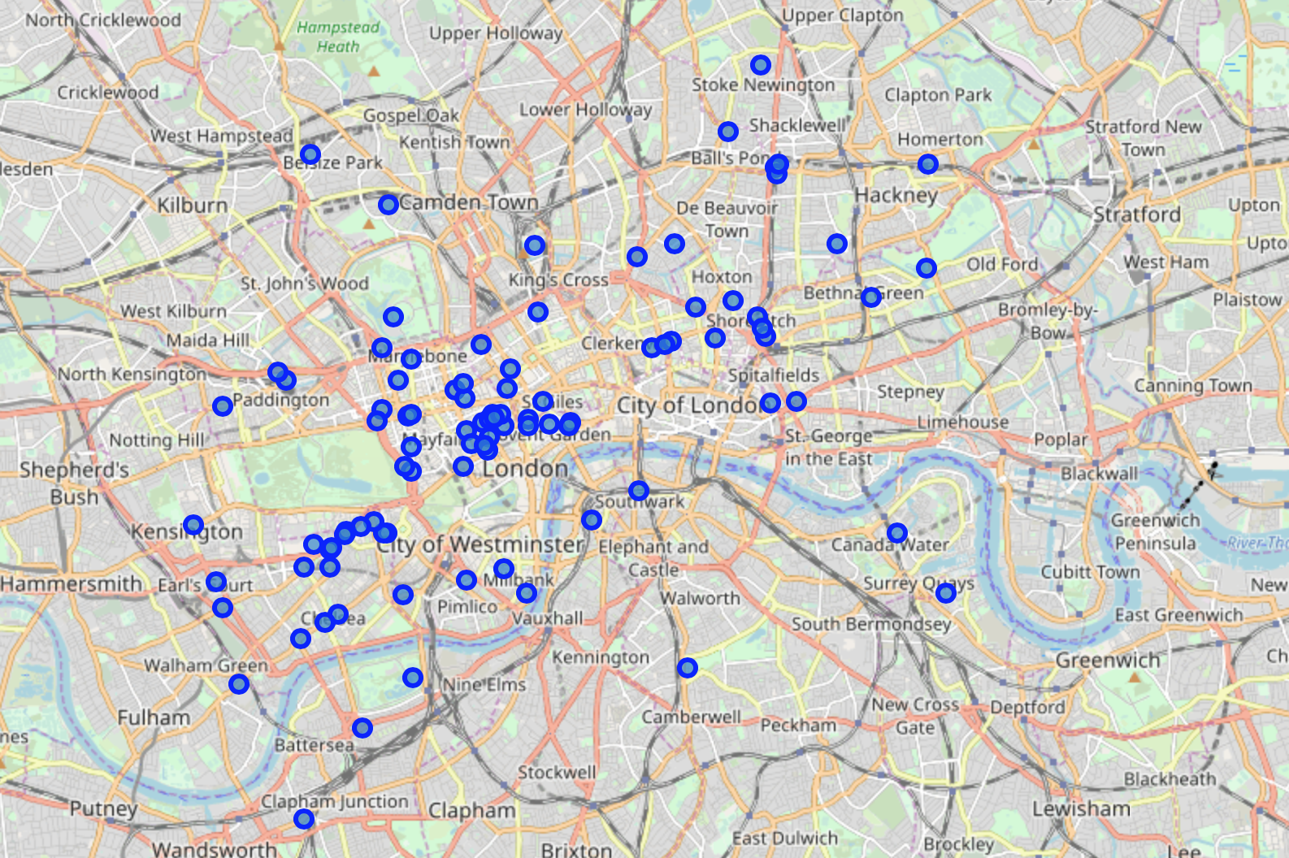
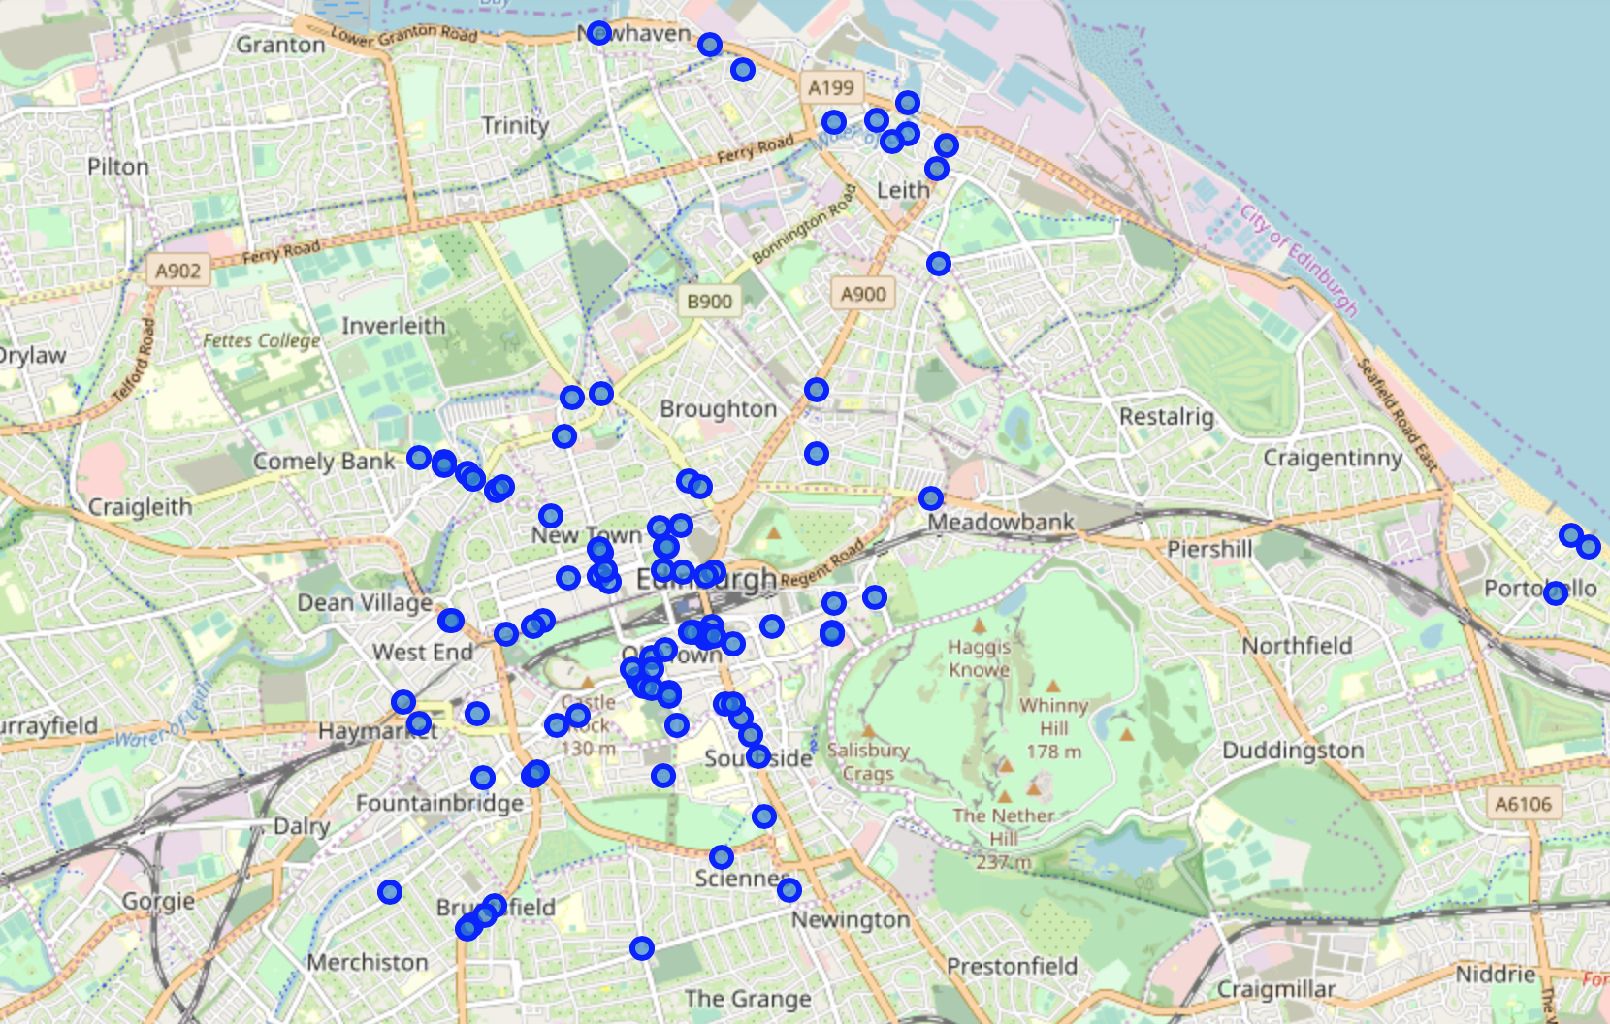
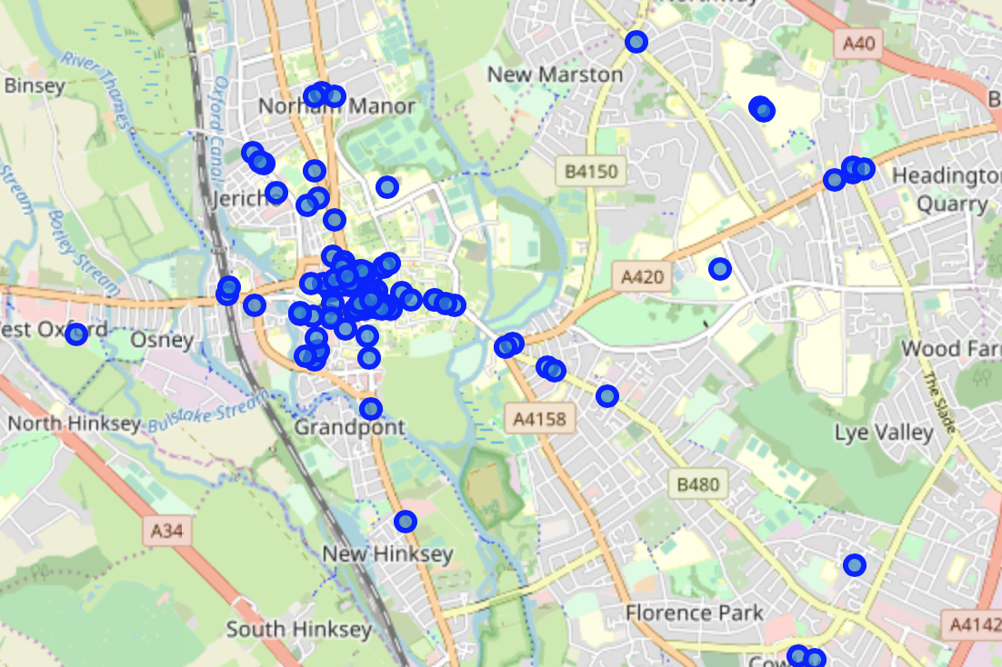
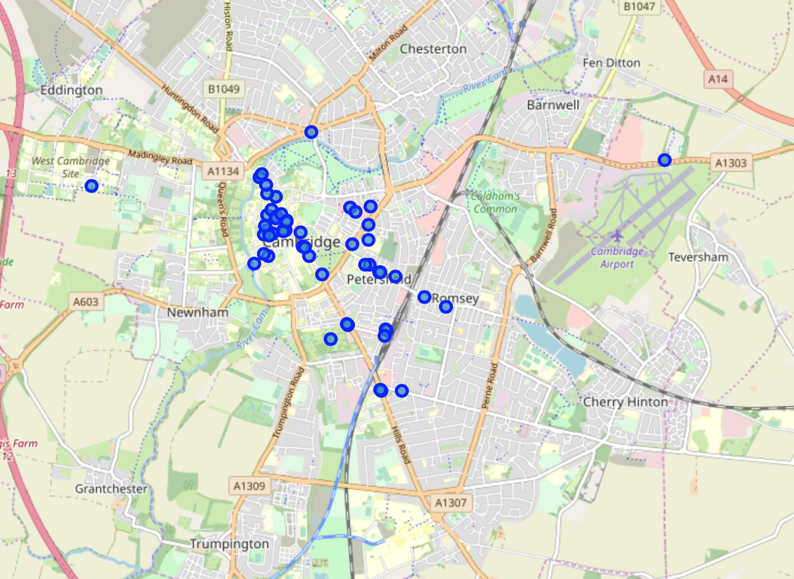
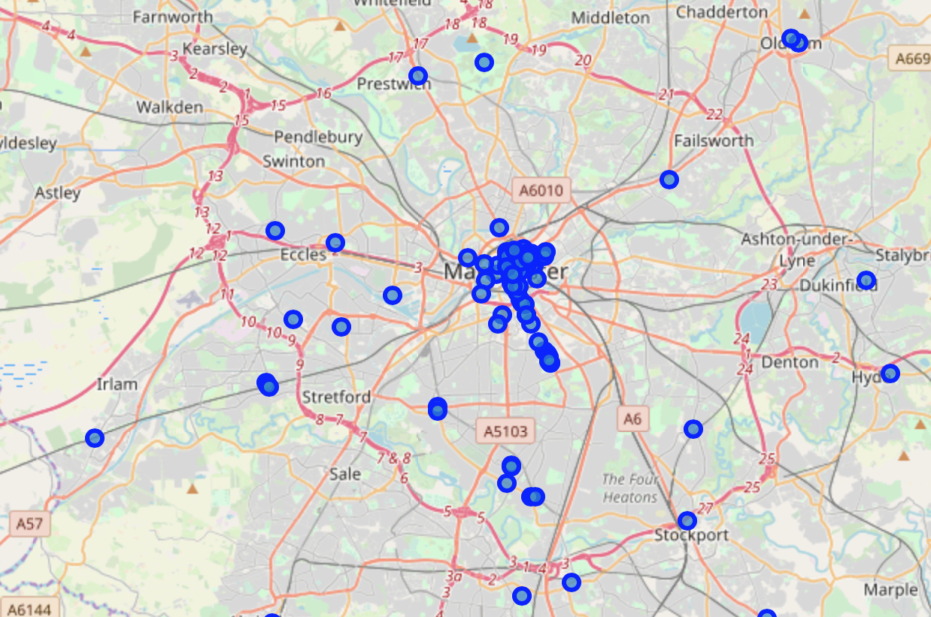
Result- Total number of cafe
London- 332
Edinburgh- 223
Cambridge- 67
Manchester- 165
Oxford- 105

Slide 6
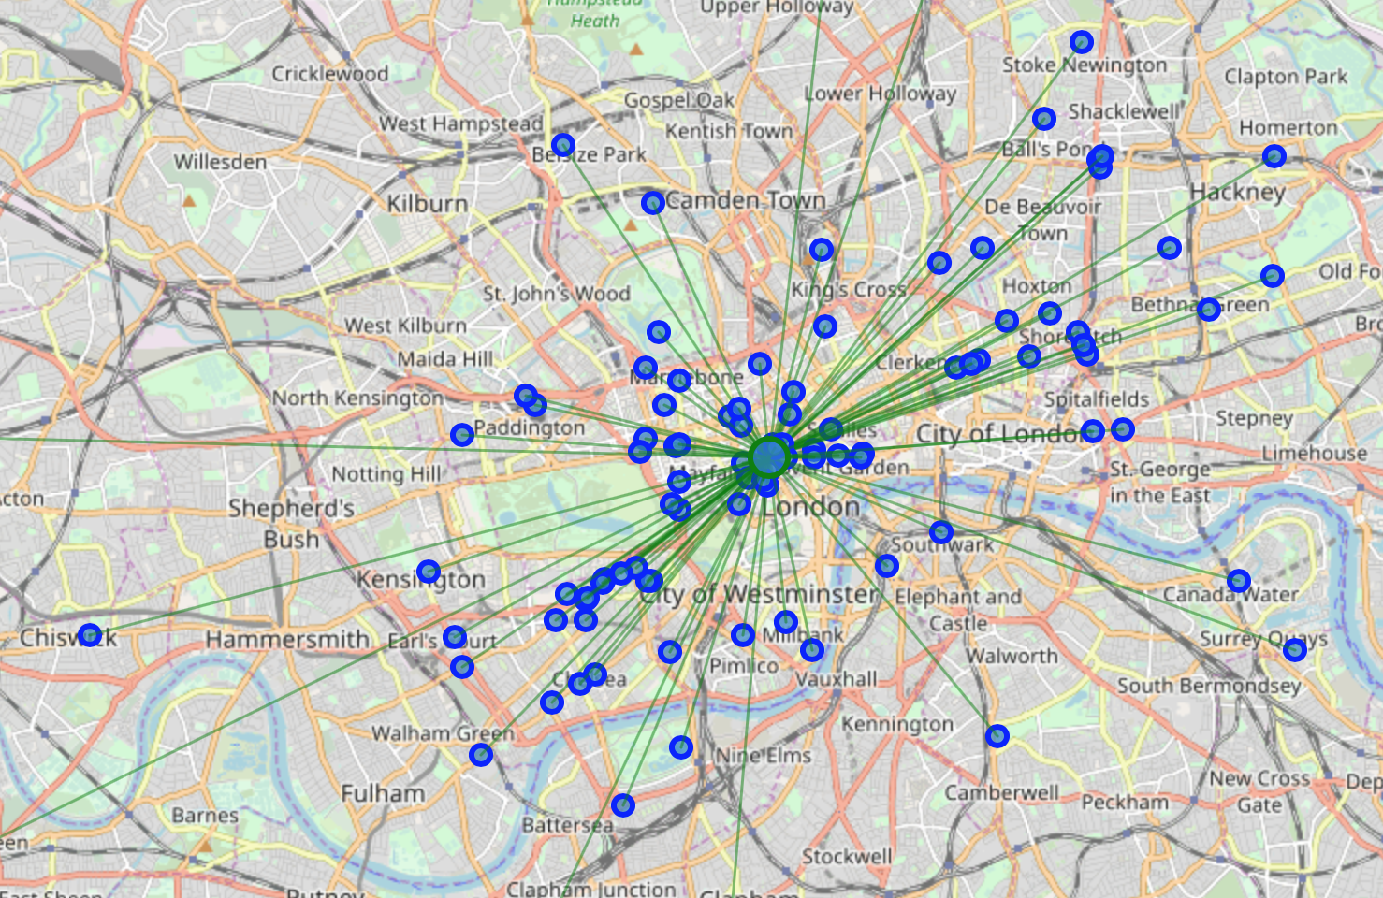
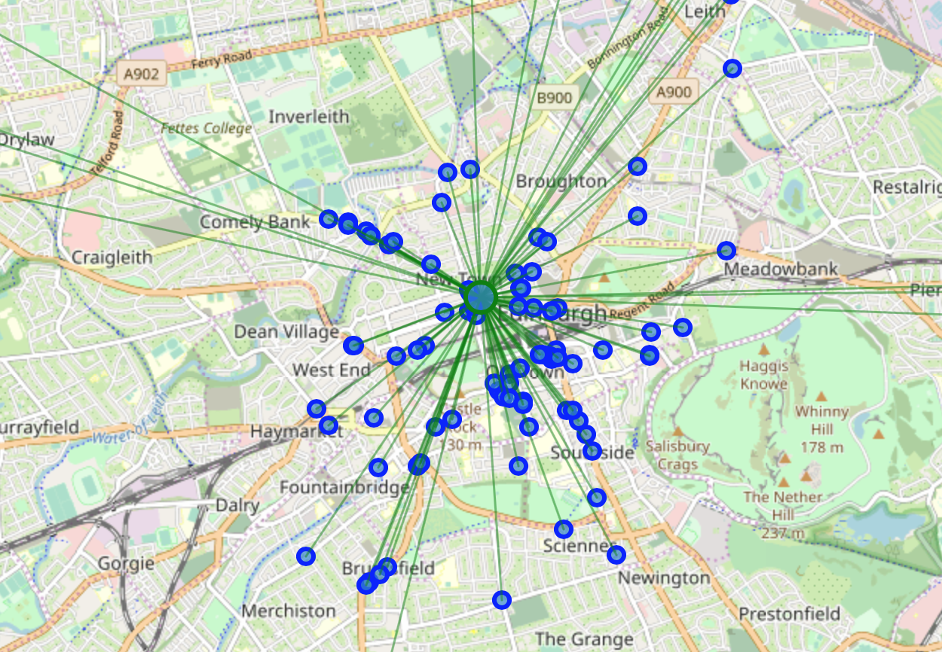
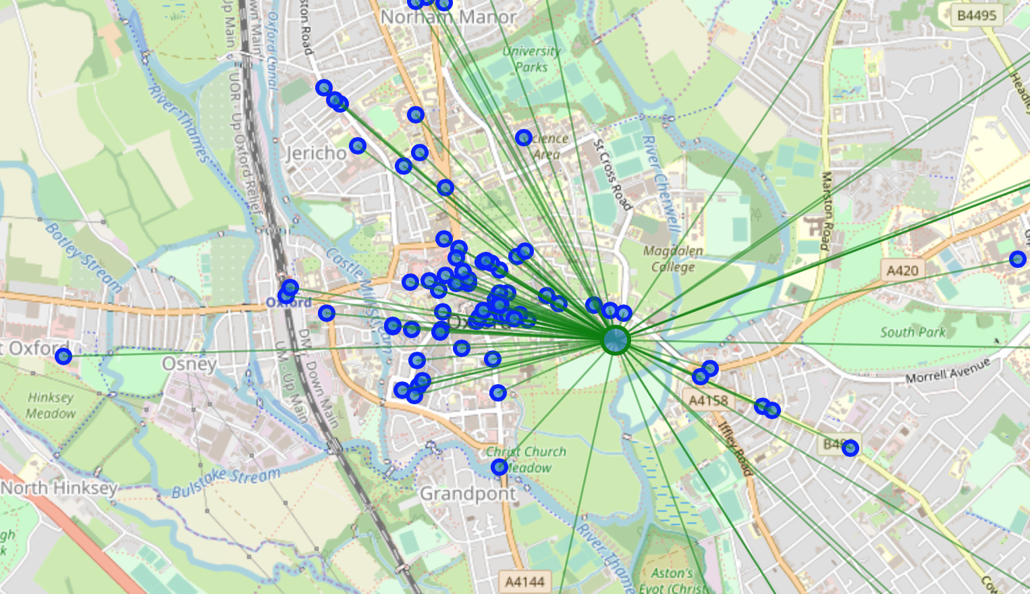
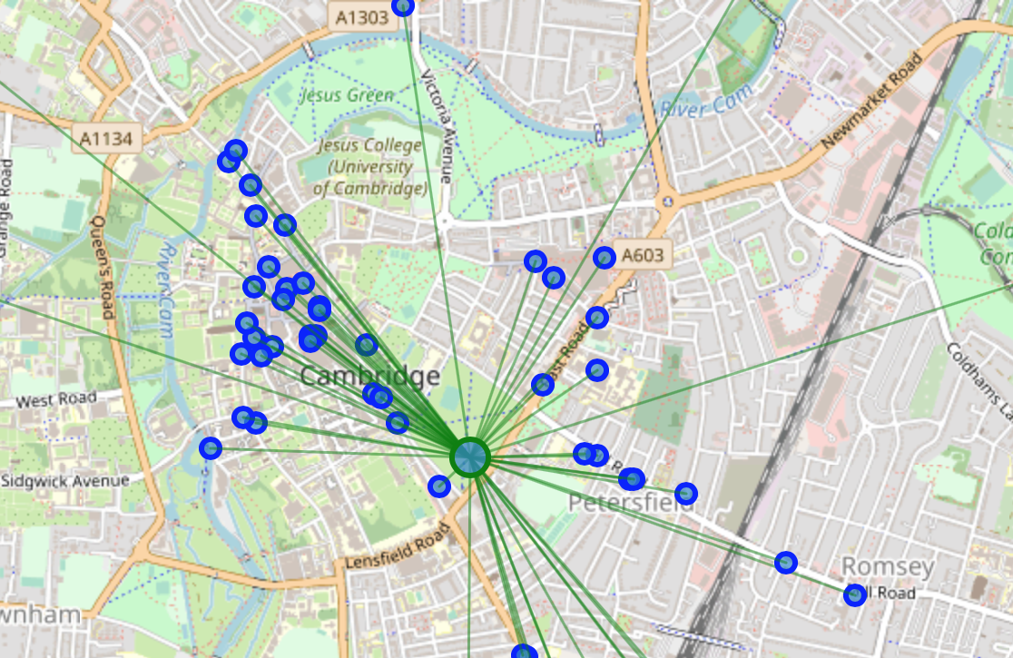
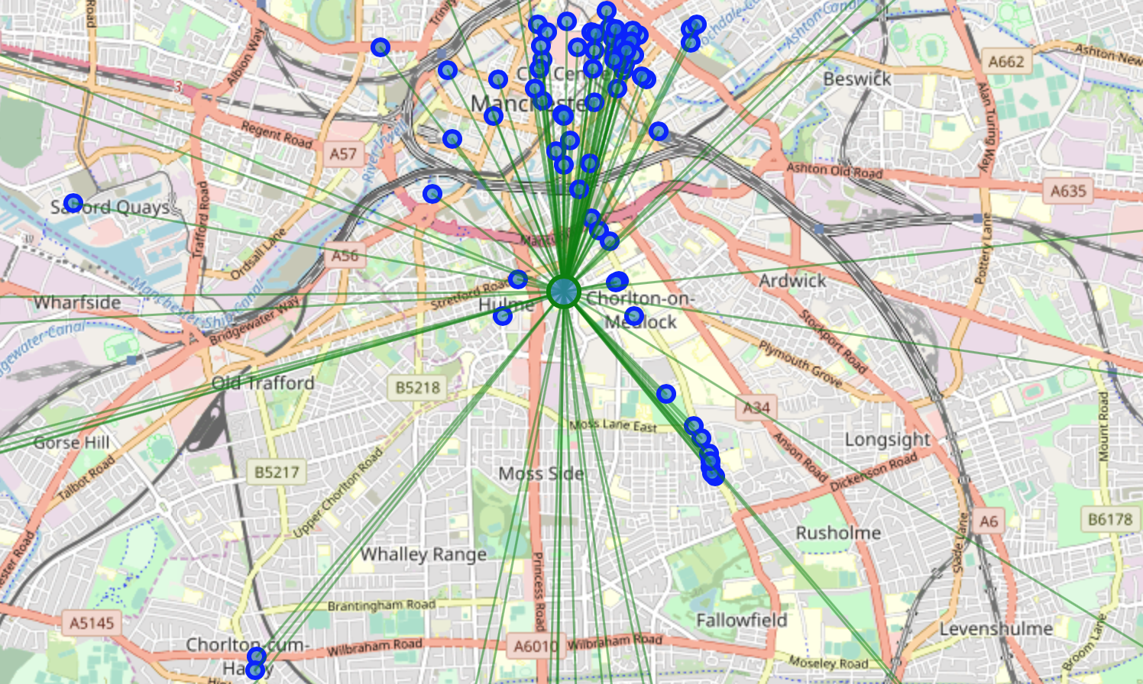
Result- Mean distance
London- 0.0403
Edinburgh- 0.0213
Cambridge- 0.0172
Manchester- 0.0414
Oxford- 0.0195

Slide 7
Discussion
London has the highest number of cafe in the city. It would be recommended to visit London to have greatest access to most number of cafe in the country. However, cafe location in Cambridge appears to be denser than the other cities. Albeit the lowest number of cafe, Cambridge is highly recommended for tourists who have limited amount of time to explore cafe in a city due to the highly densed location of cafe in the city (practically speaking, it is impossible to visit hundreds of cafe in a single trip).

Slide 8
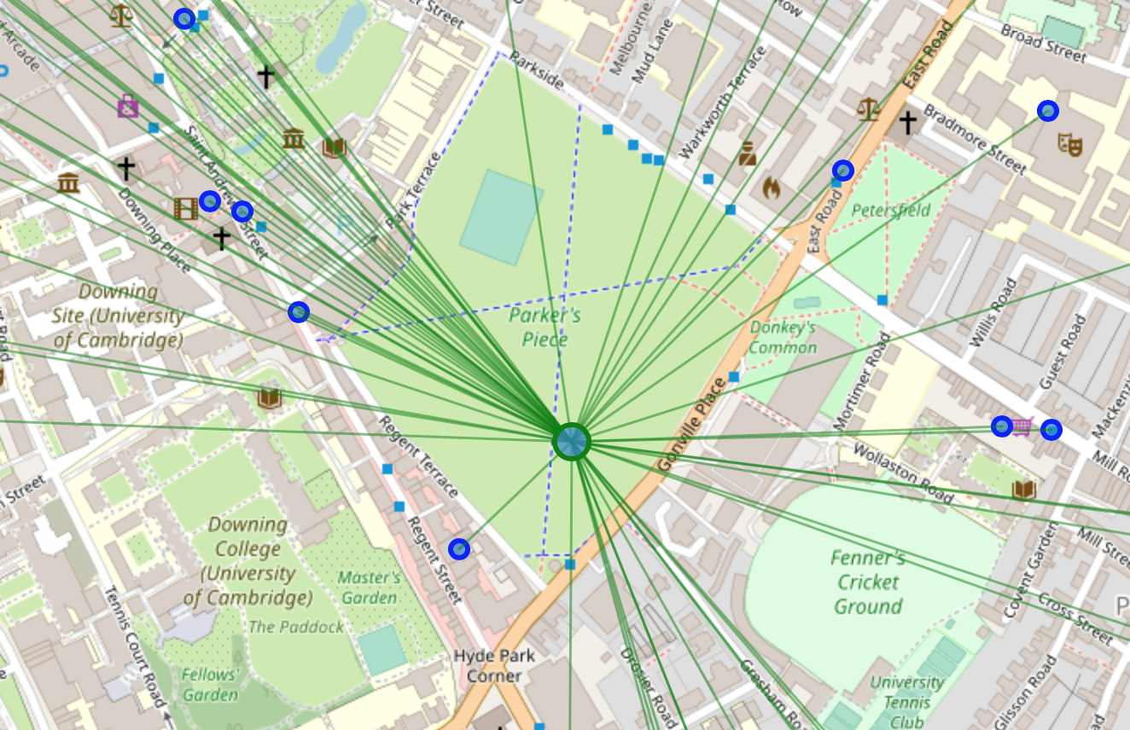
Discussion
Tourists are recommended to book accomodation around 'Parker's piece' in Cambridge as this location is the mean coordinate of all cafe locations.

